Slide 1
Chapter 2
Instructions: Language of the Computer
Notes:
The University of Adelaide, School of Computer Science
Chapter 2 — Instructions: Language of the Computer

Slide 2
Procedure Example – Guess if Correct!
C code:
int main ()
{
int a = add2(5 + 10);
}
int add2 (int g, int h)
{
return (g + h);
}
Assembly code:
00 | main:
 | addi $t0, $0, 5
04 | addi $t1, $0, 10
08 | j add2
12 | add $s0, $0, $t2 # a = s0
…. | ………………………..
100 | add2:
 | add $t2, $t1, $t0
104 | J 12
Chapter 2 — Instructions: Language of the Computer — <number>
Notes:
The University of Adelaide, School of Computer Science
Chapter 2 — Instructions: Language of the Computer

Slide 3
Procedure Example – Guess if Correct!
C code:
int main ()
{
int a = add2(5 , 10);
int b = add2(15 , 20);
}
int add2 (int g, int h)
{
return (g + h);
}
Assembly code:
00 | main: addi $t0, $0, 5
04 | addi $t1, $0, 10
08 | j add2
12 | add $s0, $0, $t2 # a = s0
16 | addi $t0, $0, 15
20 | addi $t1, $0, 20
24 | j add2
28 | add $s1, $0, $t2 # b = s1
…. | ………………………..
100 | add2:
 | add $t2, $t1, $t0
104 | J ? # jump to 16 or 28 ????
Using the simple J with fixed return address is not valid in case of multiple calls for the same function!!!
Chapter 2 — Instructions: Language of the Computer — <number>
Notes:
The University of Adelaide, School of Computer Science
Chapter 2 — Instructions: Language of the Computer

Slide 4
Procedure Calling
Steps required
  Place parameters in registers
    using a0 to a3
  Transfer control to procedure
    using jal Label
  Acquire storage for procedure
    for non temporary registers that would be used in the procedure; usually s0 to s7
  Perform procedure’s operations
  Place result in register for caller
    Using v0 and v1
  Return to place of call
    using jr $ra
§2.8 Supporting Procedures in Computer Hardware
Chapter 2 — Instructions: Language of the Computer — <number>
Notes:
The University of Adelaide, School of Computer Science
Chapter 2 — Instructions: Language of the Computer

Slide 5
Procedure Call Instructions
Procedure call: jump and link
jal ProcedureLabel
  Address of following instruction put in $ra
  Jumps to target address
Procedure return: jump register
jr $ra
  Copies $ra to program counter
  Can also be used for computed jumps
    e.g., for case/switch statements
Chapter 2 — Instructions: Language of the Computer — <number>
Notes:
The University of Adelaide, School of Computer Science
Chapter 2 — Instructions: Language of the Computer

Slide 6
Register Usage
$a0 – $a3: arguments (reg’s 4 – 7)
$v0, $v1: result values (reg’s 2 and 3)
$t0 – $t9: temporaries
  Can be overwritten by callee
$s0 – $s7: saved
  Must be saved/restored by callee
$gp: global pointer for static data (reg 28)
$sp: stack pointer (reg 29)
$fp: frame pointer (reg 30)
$ra: return address (reg 31)
Chapter 2 — Instructions: Language of the Computer — <number>
Notes:
The University of Adelaide, School of Computer Science
Chapter 2 — Instructions: Language of the Computer

Slide 7
Procedure Example – Correct!
C code:
int main ()
{
int a = add2(5 , 10);
int b = add2(15 , 20);
}
int add2 (int g, int h)
{
return (g + h);
}
Assembly code:
00 | main: addi $a0, $0, 5
04 | addi $a1, $0, 10
08 | jal add2
12 | add $s0, $0, $t2 # a = s0
16 | addi $a0, $0, 15
20 | addi $a1, $0, 20
24 | jal add2
28 | add $s1, $0, $t2 # b = s1
…. | ………………………..
100 | add2:
 | add $t2, $t1, $t0
104 | jr $ra
The use of jal and jr ensures return to the next line of the caller instruction
The stack is not used since the procedure does not make use of any of the $s registers
Chapter 2 — Instructions: Language of the Computer — <number>
Notes:
The University of Adelaide, School of Computer Science
Chapter 2 — Instructions: Language of the Computer

Slide 8
Leaf Procedure Example 1
Leaf Procedure is the procedure that do not make any calls to other procedures (no nested calls)
C code:
int main ()
{
int a = add2(5 , 10);
}
int add2 (int g, int h)
{
return (g + h);
}
Assembly code:
00 | main:
 | addi $a0, $0, 5
04 | addi $a1, $0, 10
08 | jal add2
12 | add $s0, $0, $v0 # a = s0
…. | ………………………..
100 | add2:
 | add $v0, $a1, $a0
104 | jr $ra
Chapter 2 — Instructions: Language of the Computer — <number>
Notes:
The University of Adelaide, School of Computer Science
Chapter 2 — Instructions: Language of the Computer

Slide 9
Leaf Procedure Example 2
C code:
int main ()
{
int a = add2(5,10);
int b = add2(15,20);
}
int add2 (int g, int h)
{
return (g + h);
}
Assembly code:
00 | main: addi $a0, $0, 5
04 | addi $a1, $0, 10
08 | jal add2
12 | add $s0, $0, $v0 # a = s0
16 | addi $a0, $0, 15
20 | addi $a1, $0, 20
24 | jal add2
28 | add $s1, $0, $v0 # b = s1
…. | ………………………..
100 | add2:
 | add $v0, $t1, $t0
104 | jr $ra
The stack is not used since the procedure does not make use of any of the $s registers
Chapter 2 — Instructions: Language of the Computer — <number>
Notes:
The University of Adelaide, School of Computer Science
Chapter 2 — Instructions: Language of the Computer

Slide 10
Leaf Procedure Example 3
C code:
int leaf_example (int g,int h,int i,int j)
{ int f;
f = (g + h) - (i + j);
return f;
}
  Arguments g, …, j in $a0, …, $a3
  f in $s0 (hence, need to save $s0 on stack)
  Result in $v0
Chapter 2 — Instructions: Language of the Computer — <number>
Notes:
The University of Adelaide, School of Computer Science
Chapter 2 — Instructions: Language of the Computer

Slide 11
Leaf Procedure Example
MIPS code:
leaf_example:
addi $sp, $sp, -4
sw $s0, 0($sp)
add $t0, $a0, $a1
add $t1, $a2, $a3
sub $s0, $t0, $t1
add $v0, $s0, $zero
lw $s0, 0($sp)
addi $sp, $sp, 4
jr $ra
Save $s0 on stack
Procedure body
Result
52
48
44
40
36
32
28
Restore $s0
Return
SP=40
SP=36
–4
$s0
Chapter 2 — Instructions: Language of the Computer — <number>
Notes:
The University of Adelaide, School of Computer Science
Chapter 2 — Instructions: Language of the Computer

Slide 12
Non-Leaf Procedures
Procedures that call other procedures
For nested call, caller needs to save on the stack:
  Its return address
  Any arguments and temporaries needed after the call
Restore from the stack after the call
Chapter 2 — Instructions: Language of the Computer — <number>
Notes:
The University of Adelaide, School of Computer Science
Chapter 2 — Instructions: Language of the Computer

Slide 13
Non-Leaf Procedure Example 1
C code:
int main (){
int x = add4(1,2,3,4); // $s0=>x
}
int add2 (int g, int h){
return (g + h);
}
int add4 (int g, int h, int i, int j){
int a = add2(g , h);
int b = add2(i , j);
int c = add2(a , b);
return c;
}
Chapter 2 — Instructions: Language of the Computer — <number>
Notes:
The University of Adelaide, School of Computer Science
Chapter 2 — Instructions: Language of the Computer

Slide 14
Non-Leaf Procedure Example 1
Assembly code:
00 | main: addi $a0, $0, 1
04 | addi $a1, $0, 2
08 | addi $a2, $0, 3
12 | addi $a3, $0, 4
16 | jal add4
20 | add $s0, $0, $v0
…. | ………………………..
100 | add2: add $v0, $a1, $a0
104 | jr $ra
…. | ………………………..
200 | add4: addi $sp, $sp, -4
204 | sw $ra, 0(sp)
208 | jal add2 # $v0 = a = g + h
212 | add $t0, $0, $v0 # $t0 = a
216 | add $a0, $a2, $0
220 | add $a1, $a3, $0
224 | jal add2 # $v0 = b = i + j
228 | add $t1, $0, $v0 # $t1 = b
232 | add $a0, $t0, $0
236 | add $a1, $t1, $0
240 | jal add2 # $v0 = c = a + b
244 | lw $ra, 0($sp)
248 | addi $sp, $sp, 4
252 | Jr $ra # jump to 20
256
260
264
268
$ra
20
212
228
244
20
$sp
1000
996
1000
Chapter 2 — Instructions: Language of the Computer — <number>

Slide 15
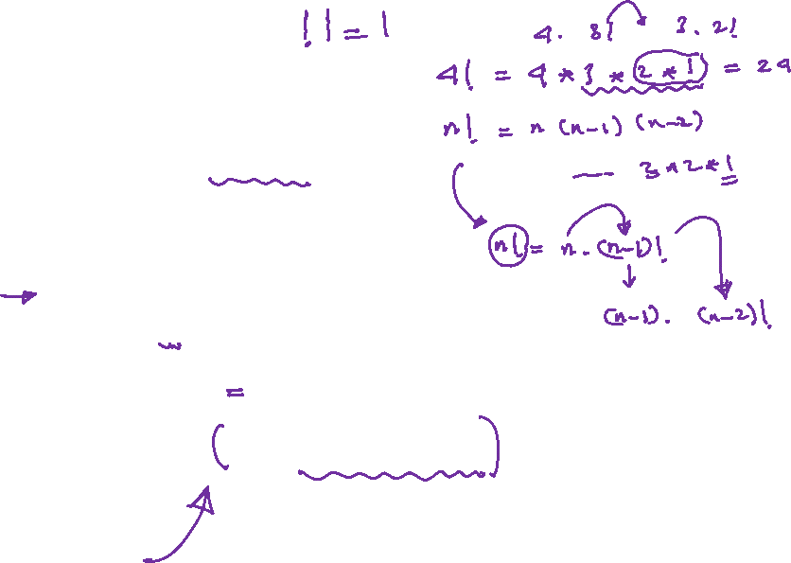
Non-Leaf Procedure Example 2
C code
int main(){
int x=fact(4);
}
int fact (int n){
if (n == 1)
return 1;
else
return n * fact(n - 1);
}
Chapter 2 — Instructions: Language of the Computer — <number>
Notes:
The University of Adelaide, School of Computer Science
Chapter 2 — Instructions: Language of the Computer

Slide 16
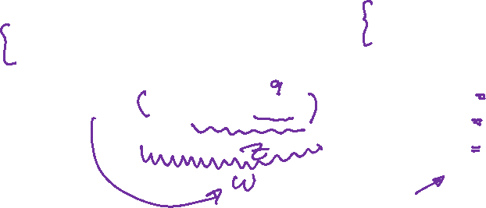
Non-Leaf Procedure Example 2
int main()
{
int x=fact(4);
}
int fact (int n)
{
if (n == 1)
return 1;
else
return n * fact(n - 1);
}
int main()
{
int x=fact(4);
}
int fact (int n){
if (n == 1)
return 1;
else{
int q = n – 1;
int z = fact(q);
int w = n * z;
return w;
}
}
Equivalent and easier to code function
Chapter 2 — Instructions: Language of the Computer — <number>
Notes:
The University of Adelaide, School of Computer Science
Chapter 2 — Instructions: Language of the Computer

Slide 17
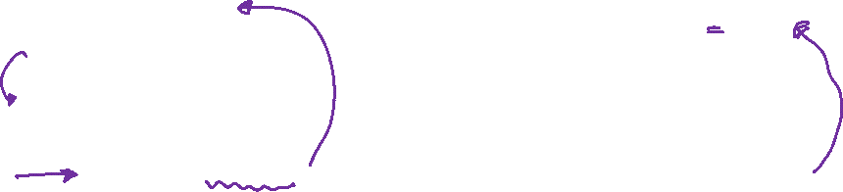
Non-Leaf Procedure Example 2
int main()
{
int x=fact(4);
}
int fact (int 4){
if (4 == 1)
return 1;
else{
int q = 4 – 1;
int z = fact(3);
int w = n * z;
return w;
}
}
int main()
{
int x=fact(4);
}
int fact (int 3){
if (3 == 1)
return 1;
else{
int q = 3 – 1;
int z = fact(2);
int w = n * z;
return w;
}
}
Chapter 2 — Instructions: Language of the Computer — <number>
Notes:
The University of Adelaide, School of Computer Science
Chapter 2 — Instructions: Language of the Computer

Slide 18
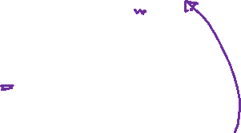
Non-Leaf Procedure Example 2
int main()
{
int x=fact(4);
}
int fact (int 3){
if (3 == 1)
return 1;
else{
int q = 3 – 1;
int z = fact(2);
int w = n * z;
return w;
}
}
int main()
{
int x=fact(4);
}
int fact (int 2){
if (2 == 1)
return 1;
else{
int q = 2 – 1;
int z = fact(1);
int w = n * z;
return w;
}
}
Chapter 2 — Instructions: Language of the Computer — <number>
Notes:
The University of Adelaide, School of Computer Science
Chapter 2 — Instructions: Language of the Computer

Slide 19

Non-Leaf Procedure Example 2
int main()
{
int x=fact(4);
}
int fact (int 2){
if (2 == 1)
return 1;
else{
int q = 2 – 1;
int z = fact(1);
int w = n * z;
return w;
}
}
int main()
{
int x=fact(4);
}
int fact (int 1){
if (1 == 1)
return 1;
else{
int q = n – 1;
int z = fact(q);
int w = n * z;
return w;
}
}
Chapter 2 — Instructions: Language of the Computer — <number>
Notes:
The University of Adelaide, School of Computer Science
Chapter 2 — Instructions: Language of the Computer

Slide 20
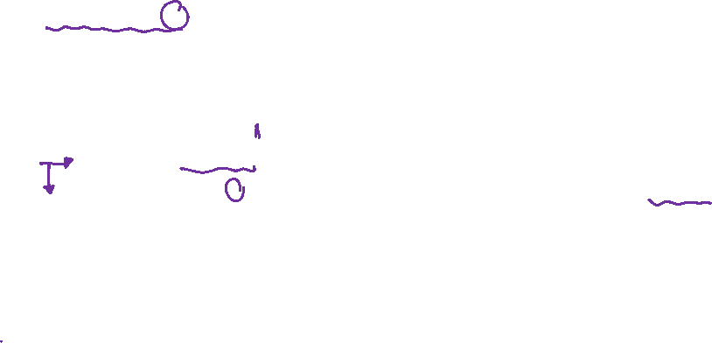
Non-Leaf Procedure Example 2
int main()
{
int x=fact(4);
}
int fact (int 2){
if (2 == 1)
return 1;
else{
int q = 2 – 1;
int z = fact(1);
int w = 2 * 1;
return 2;
}
}
int main()
{
int x=fact(4);
}
int fact (int 1){
if (1 == 1)
return 1;
else{
int q = n – 1;
int z = fact(q);
int w = n * z;
return w;
}
}
Chapter 2 — Instructions: Language of the Computer — <number>
Notes:
The University of Adelaide, School of Computer Science
Chapter 2 — Instructions: Language of the Computer

Slide 21

Non-Leaf Procedure Example 2
int main()
{
int x=fact(4);
}
int fact (int 3){
if (3 == 1)
return 1;
else{
int q = 3 – 1;
int z = fact(2);
int w = 3 * 2;
return 3 * 2;
}
}
int main()
{
int x=fact(4);
}
int fact (int 2){
if (2 == 1)
return 1;
else{
int q = 2 – 1;
int z = fact(1);
int w = 2 * 1;
return 2;
}
}
Chapter 2 — Instructions: Language of the Computer — <number>
Notes:
The University of Adelaide, School of Computer Science
Chapter 2 — Instructions: Language of the Computer

Slide 22
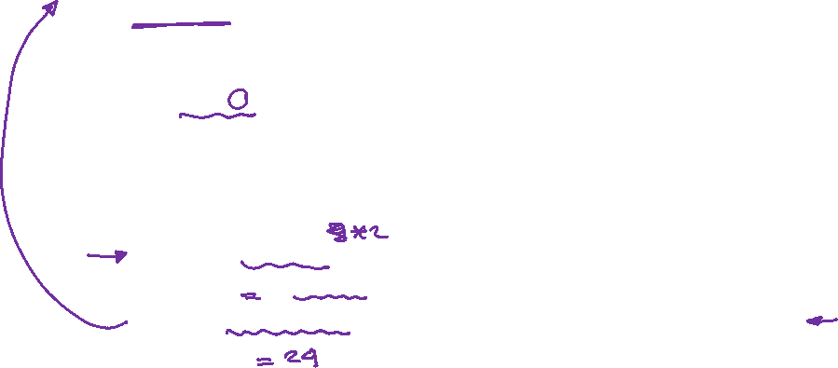
Non-Leaf Procedure Example 2
int main()
{
int x=fact(4);
}
int fact (int 4){
if (4 == 1)
return 1;
else{
int q = 4 – 1;
int z = fact(3);
int w = 4 * 3 * 2;
return 4 * 3 * 2;
}
}
int main()
{
int x=fact(4);
}
int fact (int 3){
if (3 == 1)
return 1;
else{
int q = 3 – 1;
int z = fact(2);
int w = 3 * 2;
return 3 * 2;
}
}
=24
Chapter 2 — Instructions: Language of the Computer — <number>
Notes:
The University of Adelaide, School of Computer Science
Chapter 2 — Instructions: Language of the Computer

Slide 23
Non-Leaf Procedure Example 2
00 | main: addi $a0, $0, 4
04 | jal fact
08 | add $s0, $0, $v0
…. | ………………………..
200 | fact: addi $t0, $0, 1
204 | beq $a0, $t0, finish
208 | addi $sp, $sp, -4
212 | sw $ra, 0(sp)
216 | addi $sp, $sp, -4
220 | sw $a0, 0(sp)
224 | addi $a0, $a0, -1
228 | jal fact
232 | lw $a0, 0(sp)
236 | addi $sp, $sp, 4
240 | mul $v0, $a0, $v0
244 | lw $ra, 0($sp)
248 | addi $sp, $sp, 4
252 | jr $ra
256 | finish: addi $v0, $0, 1
260 | jr $ra
int main(){
int x=fact(4);
}
int fact (int n){
if (n == 1)
return 1;
else{
int q = n – 1;
int z = fact(q);
int w = n * z;
return w;
}
}
Chapter 2 — Instructions: Language of the Computer — <number>

Slide 24
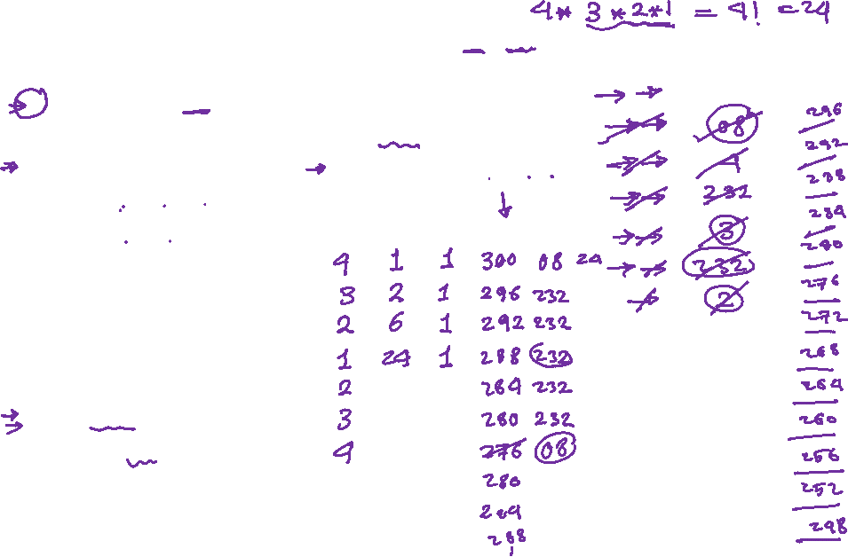
Non-Leaf Procedure Example 2
00 | main: addi $a0, $0, 4
04 | jal fact
08 | add $s0, $0, $v0
…. | ………………………..
200 | fact: addi $t0, $0, 1
204 | beq $a0, $t0, finish
208 | addi $sp, $sp, -4
212 | sw $ra, 0(sp)
216 | addi $sp, $sp, -4
220 | sw $a0, 0(sp)
224 | addi $a0, $a0, -1
228 | jal fact
232 | lw $a0, 0(sp)
236 | addi $sp, $sp, 4
240 | mul $v0, $a0, $v0
244 | lw $ra, 0($sp)
248 | addi $sp, $sp, 4
252 | jr $ra
256 | finish: addi $v0, $0, 1
260 | jr $ra
Stack
300
304
308
312
316
320
324
328
332
336
340
344
348
352
$a0 | $v0 | $t0 | $sp | $ra | $s0

Slide 25

Non-Leaf Procedure Example
MIPS code:
fact:
addi $sp, $sp, -8 # adjust stack for 2 items
sw $ra, 4($sp) # save return address
sw $a0, 0($sp) # save argument
slti $t0, $a0, 1 # test for n < 1
beq $t0, $zero, L1
addi $v0, $zero, 1 # if so, result is 1
addi $sp, $sp, 8 # pop 2 items from stack
jr $ra # and return
L1: addi $a0, $a0, -1 # else decrement n
jal fact # recursive call
lw $a0, 0($sp) # restore original n
lw $ra, 4($sp) # and return address
addi $sp, $sp, 8 # pop 2 items from stack
mul $v0, $a0, $v0 # multiply to get result
jr $ra # and return
Chapter 2 — Instructions: Language of the Computer — <number>
Notes:
The University of Adelaide, School of Computer Science
Chapter 2 — Instructions: Language of the Computer

Slide 26
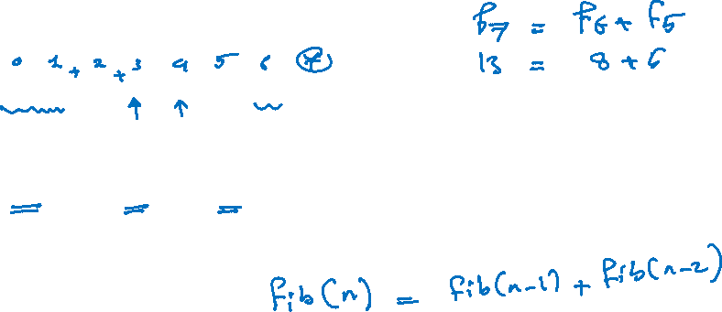
Non-Leaf Procedure Example 3
Fibonacci number:
Fibonacci series 0,1,1,2,3,5,8,13, …
Where any Fibonacci number F_{N} = F_{N-1}+F_{N-2}
  Example: F₇=F₆+F₅=8+5=13
Chapter 2 — Instructions: Language of the Computer — <number>
Notes:
The University of Adelaide, School of Computer Science
Chapter 2 — Instructions: Language of the Computer

Slide 27
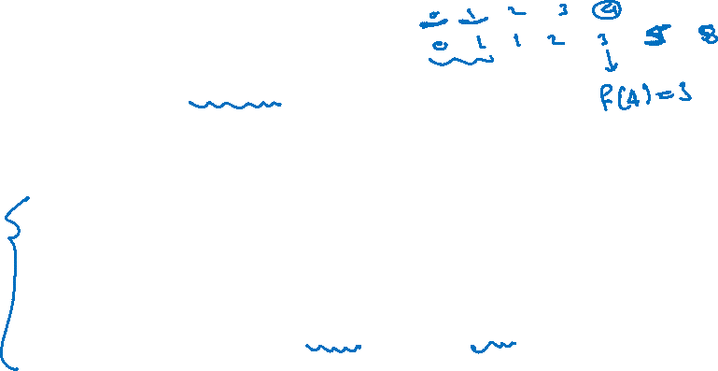
Non-Leaf Procedure Example 3
C code of Fibonacci number
int main(){
int x=fib(4);
}
int fib (int n){
if (n == 0) return 0;
if (n == 1) return 1;
return (fib(n-2)+fib(n-1));
}
Chapter 2 — Instructions: Language of the Computer — <number>
Notes:
The University of Adelaide, School of Computer Science
Chapter 2 — Instructions: Language of the Computer

Slide 28
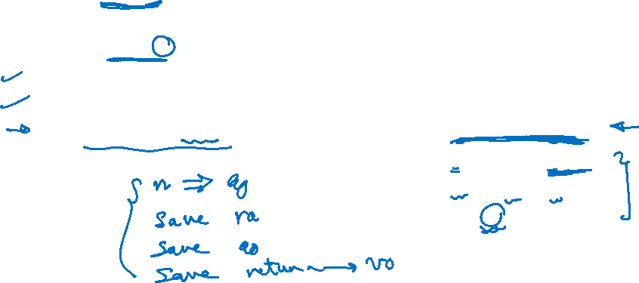
Non-Leaf Procedure Example 3
C code of Fibonacci number
int main(){
int x=fib(4);
}
int fib (int n){
if (n == 0) return 1;
if (n == 1) return 1;
return (fib(n-2)+fib(n-1));
}
Equivalent C code of Fibonacci number
int main(){
int x=fib(4);
}
int fib (int 4){
if (n == 1) return 1;
if (n == 0) return 0;
int q = fib(n-1);
int z = fib(n-2);
int w = q + z;
return w;
}
Chapter 2 — Instructions: Language of the Computer — <number>
Notes:
The University of Adelaide, School of Computer Science
Chapter 2 — Instructions: Language of the Computer

Slide 29
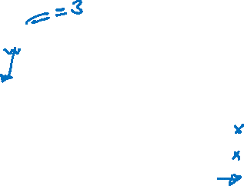
Non-Leaf Procedure Example 3
int main(){
int x=fib(4);
}
int fib (int 4){
if (4 == 1) return 1;
if (4 == 0) return 0;
int q = fib(4-1);
int z = fib(n-2);
int w = q + z;
return w;
}
int main(){
int x=fib(4);
}
int fib (int 3){
if (3 == 1) return 1;
if (3 == 0) return 0;
int q = fib(3-1);
int z = fib(n-2);
int w = q + z;
return w;
}
Chapter 2 — Instructions: Language of the Computer — <number>
Notes:
The University of Adelaide, School of Computer Science
Chapter 2 — Instructions: Language of the Computer

Slide 30

Non-Leaf Procedure Example 3
int main(){
int x=fib(4);
}
int fib (int 3){
if (3 == 1) return 1;
if (3 == 0) return 0;
int q = fib(3-1);
int z = fib(n-2);
int w = q + z;
return w;
}
int main(){
int x=fib(4);
}
int fib (int 2){
if (2 == 1) return 1;
if (2 == 0) return 0;
int q = fib(2-1);
int z = fib(n-2);
int w = q + z;
return w;
}
Chapter 2 — Instructions: Language of the Computer — <number>
Notes:
The University of Adelaide, School of Computer Science
Chapter 2 — Instructions: Language of the Computer

Slide 31
Non-Leaf Procedure Example 3
int main(){
int x=fib(4);
}
int fib (int 2){
if (2 == 1) return 1;
if (2 == 0) return 0;
int q = fib(2-1);
int z = fib(n-2);
int w = q + z;
return w;
}
int main(){
int x=fib(4);
}
int fib (int 1){
if (1 == 1) return 1;
if (1 == 0) return 0;
int q = fib(n-1);
int z = fib(n-2);
int w = q + z;
return w;
}
Chapter 2 — Instructions: Language of the Computer — <number>
Notes:
The University of Adelaide, School of Computer Science
Chapter 2 — Instructions: Language of the Computer

Slide 32

Non-Leaf Procedure Example 3
int main(){
int x=fib(4);
}
int fib (int 2){
if (2 == 1) return 1;
if (2 == 0) return 0;
int q = fib(2-1) = 1;
int z = fib(2-2);
int w = q + z;
return w;
}
int main(){
int x=fib(4);
}
int fib (int 1){
if (1 == 1) return 1;
if (1 == 0) return 0;
int q = fib(n-1);
int z = fib(n-2);
int w = q + z;
return w;
}
Chapter 2 — Instructions: Language of the Computer — <number>
Notes:
The University of Adelaide, School of Computer Science
Chapter 2 — Instructions: Language of the Computer

Slide 33

Non-Leaf Procedure Example 3
int main(){
int x=fib(4);
}
int fib (int 2){
if (2 == 1) return 1;
if (2 == 0) return 0;
int q = fib(2-1) = 1;
int z = fib(2-2) = 0;
int w = q + z;
return w;
}
int main(){
int x=fib(4);
}
int fib (int 0){
if (0 == 1) return 1;
if (0 == 0) return 0;
int q = fib(1-1);
int z = fib(n-2);
int w = q + z;
return w;
}
Chapter 2 — Instructions: Language of the Computer — <number>
Notes:
The University of Adelaide, School of Computer Science
Chapter 2 — Instructions: Language of the Computer

Slide 34
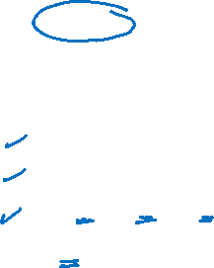
Non-Leaf Procedure Example 3
int main(){
int x=fib(4);
}
int fib (int 2){
if (2 == 1) return 1;
if (2 == 0) return 0;
int q = fib(2-1) = 1;
int z = fib(2-2) = 0;
int w = 0 + 1 = 1;
return 1;
}
int main(){
int x=fib(4);
}
int fib (int 0){
if (0 == 1) return 1;
if (0 == 0) return 0;
int q = fib(1-1);
int z = fib(n-2);
int w = q + z;
return w;
}
Chapter 2 — Instructions: Language of the Computer — <number>
Notes:
The University of Adelaide, School of Computer Science
Chapter 2 — Instructions: Language of the Computer

Slide 35

Non-Leaf Procedure Example 3
int main(){
int x=fib(4);
}
int fib (int 3){
if (3 == 1) return 1;
if (3 == 0) return 0;
int q = fib(3-1) = 1;
int z = fib(3-2);
int w = q + z;
return w;
}
int main(){
int x=fib(4);
}
int fib (int 2){
if (2 == 1) return 1;
if (2 == 0) return 0;
int q = fib(2-1) = 1;
int z = fib(2-2) = 0;
int w = q + z = 1;
return 1;
}
Chapter 2 — Instructions: Language of the Computer — <number>
Notes:
The University of Adelaide, School of Computer Science
Chapter 2 — Instructions: Language of the Computer

Slide 36
Non-Leaf Procedure Example 3
int main(){
int x=fib(4);
}
int fib (int 3){
if (3 == 1) return 1;
if (3 == 0) return 0;
int q = fib(3-1) = 1;
int z = fib(3-2);
int w = q + z;
return w;
}
int main(){
int x=fib(4);
}
int fib (int 1){
if (1 == 1) return 1;
if (n == 0) return 0;
int q = fib(n-1);
int z = fib(n-2);
int w = q + z;
return w;
}
Chapter 2 — Instructions: Language of the Computer — <number>
Notes:
The University of Adelaide, School of Computer Science
Chapter 2 — Instructions: Language of the Computer

Slide 37

Non-Leaf Procedure Example 3
int main(){
int x=fib(4);
}
int fib (int 3){
if (3 == 1) return 1;
if (3 == 0) return 0;
int q = fib(3-1) = 1;
int z = fib(3-2) = 1;
int w = q + z = 2;
return 2;
}
int main(){
int x=fib(4);
}
int fib (int 1){
if (1 == 1) return 1;
if (1 == 0) return 0;
int q = fib(n-1);
int z = fib(n-2);
int w = q + z;
return w;
}
Chapter 2 — Instructions: Language of the Computer — <number>
Notes:
The University of Adelaide, School of Computer Science
Chapter 2 — Instructions: Language of the Computer

Slide 38

Non-Leaf Procedure Example 3
int main(){
int x=fib(4);
}
int fib (int 4){
if (4 == 1) return 1;
if (4 == 0) return 0;
int q = fib(4-1) = 2;
int z = fib(4-2);
int w = q + z;
return w;
}
int main(){
int x=fib(4);
}
int fib (int 3){
if (3 == 1) return 1;
if (3 == 0) return 0;
int q = fib(3-1) = 1;
int z = fib(3-2) = 1;
int w = q + z = 2;
return 2;
}
Chapter 2 — Instructions: Language of the Computer — <number>
Notes:
The University of Adelaide, School of Computer Science
Chapter 2 — Instructions: Language of the Computer

Slide 39

Non-Leaf Procedure Example 3
int main(){
int x=fib(4);
}
int fib (int 4){
if (4 == 1) return 1;
if (4 == 0) return 0;
int q = fib(4-1) = 2;
int z = fib(4-2);
int w = q + z;
return w;
}
int main(){
int x=fib(4);
}
int fib (int 2){
if (2 == 1) return 1;
if (2 == 0) return 0;
int q = fib(2-1);
int z = fib(n-2);
int w = q + z;
return w;
}
Chapter 2 — Instructions: Language of the Computer — <number>
Notes:
The University of Adelaide, School of Computer Science
Chapter 2 — Instructions: Language of the Computer

Slide 40
Non-Leaf Procedure Example 3
int main(){
int x=fib(4);
}
int fib (int 2){
if (2 == 1) return 1;
if (2 == 0) return 0;
int q = fib(2-1);
int z = fib(n-2);
int w = q + z;
return w;
}
int main(){
int x=fib(4);
}
int fib (int 1){
if (1 == 1) return 1;
if (n == 0) return 0;
int q = fib(n-1);
int z = fib(n-2);
int w = q + z;
return w;
}
Chapter 2 — Instructions: Language of the Computer — <number>
Notes:
The University of Adelaide, School of Computer Science
Chapter 2 — Instructions: Language of the Computer

Slide 41
Non-Leaf Procedure Example 3
int main(){
int x=fib(4);
}
int fib (int 2){
if (2 == 1) return 1;
if (2 == 0) return 0;
int q = fib(2-1) = 1;
int z = fib(2-2);
int w = q + z;
return w;
}
int main(){
int x=fib(4);
}
int fib (int 1){
if (1 == 1) return 1;
if (n == 0) return 0;
int q = fib(n-1);
int z = fib(n-2);
int w = q + z;
return w;
}
Chapter 2 — Instructions: Language of the Computer — <number>
Notes:
The University of Adelaide, School of Computer Science
Chapter 2 — Instructions: Language of the Computer

Slide 42
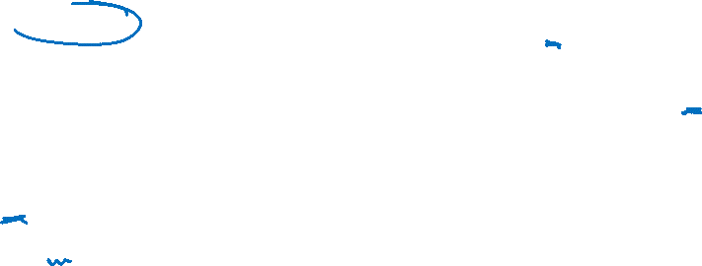
Non-Leaf Procedure Example 3
int main(){
int x=fib(4);
}
int fib (int 2){
if (2 == 1) return 1;
if (2 == 0) return 0;
int q = fib(2-1) = 1;
int z = fib(2-2) = 0;
int w = 1 + 0;
return 1;
}
int main(){
int x=fib(4);
}
int fib (int 0){
if (0 == 1) return 1;
if (0 == 0) return 0;
int q = fib(1-1);
int z = fib(n-2);
int w = q + z;
return w;
}
Chapter 2 — Instructions: Language of the Computer — <number>
Notes:
The University of Adelaide, School of Computer Science
Chapter 2 — Instructions: Language of the Computer

Slide 43
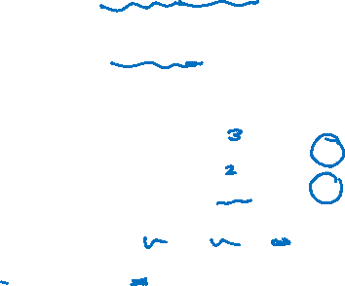
Non-Leaf Procedure Example 3
int main(){
int x=fib(4) = 3;
}
int fib (int 4){
if (4 == 1) return 1;
if (4 == 0) return 0;
int q = fib(4-1) = 2;
int z = fib(4-2) = 1;
int w = 2 + 1 = 3;
return 3;
}
int main(){
int x=fib(4);
}
int fib (int 2){
if (2 == 1) return 1;
if (2 == 0) return 0;
int q = fib(2-1) = 1;
int z = fib(2-2) = 0;
int w = q + z = 1;
return 1;
}
Chapter 2 — Instructions: Language of the Computer — <number>
Notes:
The University of Adelaide, School of Computer Science
Chapter 2 — Instructions: Language of the Computer

Slide 44
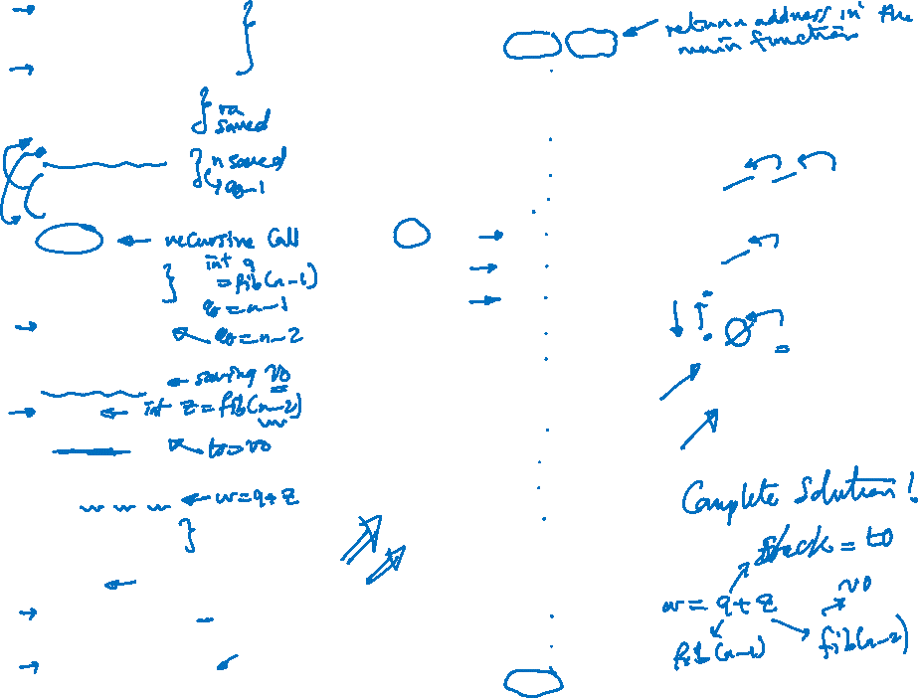
00 | Fib: beq $a0, $0, finish0
04 | addi $t0, $0, 1
08 | beq $a0, $t0, finish1
12 | addi $sp, $sp, -4
16 | sw $ra, 0($sp)
20 | addi $a0, $a0, -1
24 | addi $sp, $sp, -4
28 | sw $a0, 0($sp)
32 | jal Fib
36 | lw $a0, 0($sp)
40 | addi $sp, $sp, 4
44 | addi $a0, $a0, -1
48 | addi $sp, $sp, -4
52 | sw $v0, 0($sp)
56 | jal Fib
60 | lw $t0, 0($sp)
64 | addi $sp, $sp, 4
68 | add $v0, $v0, $t0
72 | lw $ra, 0($sp)
76 | add $sp, $sp, 4
80 | jr $ra
84 | finish0: addi $v0, $0, 0
88 | jr $ra
92 | finish1: addi $v0, $0, 1
96 | jr $ra
$a0 | $v0 | $t0 | $sp | $ra
4 | 1 | 1 | 200 | 300
3 | 0 | 1 | 196 | 36
2 | 1 | 1 | 192 | 36
1 | 1 | 2 | 188 | 36
1 | 2 |  | 184 | 60
0 | 1 |  | 180 | 36
2 | 3 |  | 176 | 60
1 |  |  | 180 | 36
3 |  |  | 176 | 60
2 |  |  | 180 | 60
2 |  |  | 184 | 300
1 |  |  | 188
 |  |  | 184
 |  |  | 188
 |  |  | 192
 |  |  | 196
 |  |  | 192
 |  |  | 196
 |  |  | 192
 |  |  | 196
 |  |  | 200
Stack
300
3 2 2
36
1
36
1 1
200
196
192
188
184
180
176
172
168

